Slide 1


Slide 2
Multi-faceted Educational Approach - Sea-Level Rise
Graphical Visualization
Topographical Maps
Video
Website

Slide 5
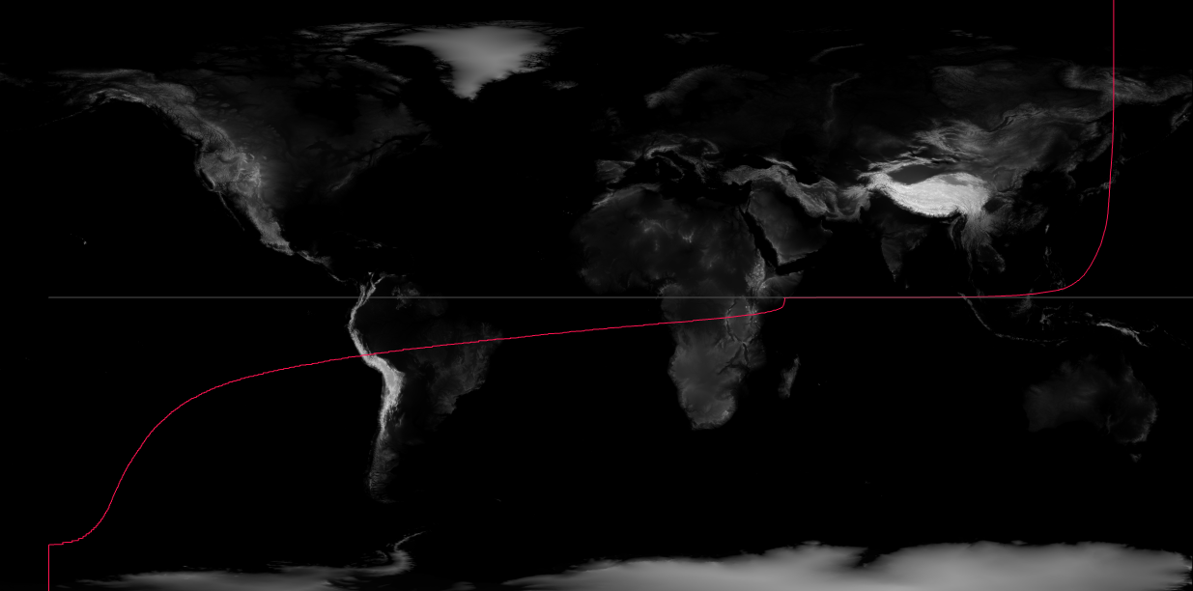

Slide 6
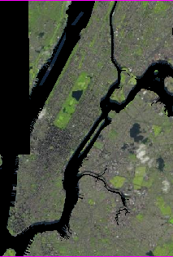
Present

Slide 7
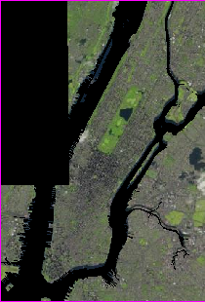
2050

Slide 8
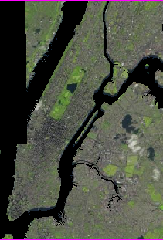
2100

Slide 9
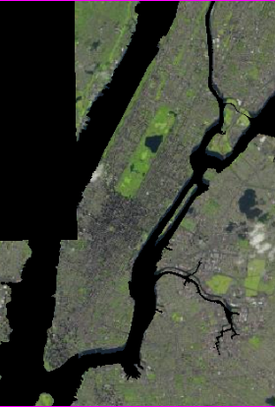
2200

Slide 10
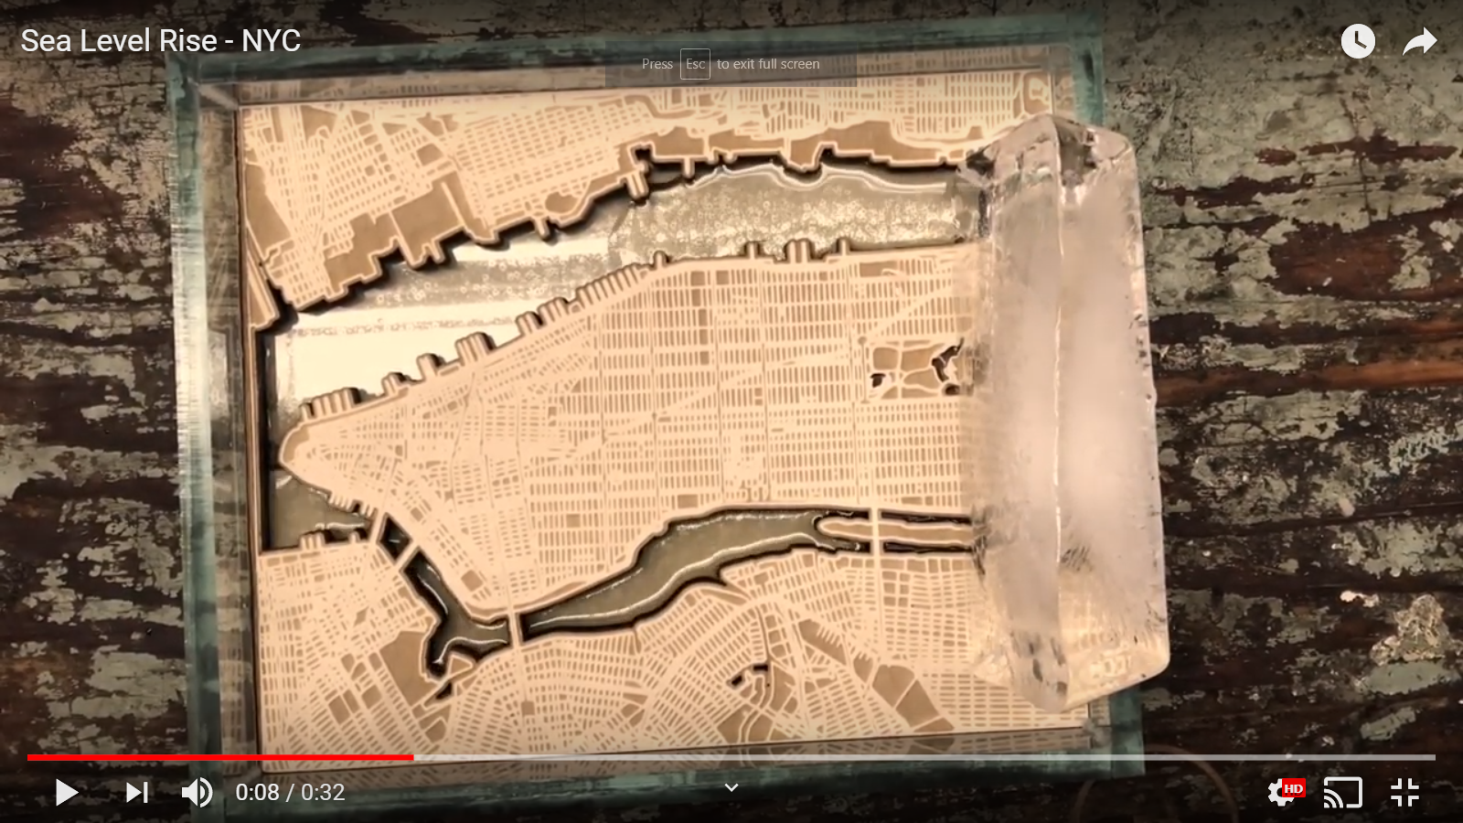
Video

